Slide 1
Janakalyan Microfinance Research Project
Business Expansion Driven with Data Analytics
Presented By-
Shantanu Mitra, Team Lead
Vivek K. Singh, Assistant Professor - IS&T, College of Business Administration, University Of Missouri - St. Louis
Rushikesh Maheshwari, Graduate Student, MS-BAIS, University Of South Florida

Slide 2
Overview
Project Objective and Problem Statement
Data Collection and Cleansing
Exploratory Analysis
Data Model and Results
Step Ahead

Slide 3

Project Objective and Problem Statement
Objective:
Drive the efficient expansion of current Janakalyan operational locations to new regions using data analytics
Problem Statement:
To predict whether a branch is going to be profitable or not by analyzing current data of operational branches along with other demographic factors

Slide 4
Data Collection and Cleansing
Data Collection Sources:
Janakalyan Operations Data
httpts://data.gov.in/
https://www.census2011.co.in/
https://unemploymentinindia.cmie.com/
Data Cleansing
Removed unnecessary columns
Handled Missing Values by data imputation
Generated Target variable of ‘Profit’ and ‘Loss’
The data was collected using Web-Scrapping and cleansed using R

Slide 5
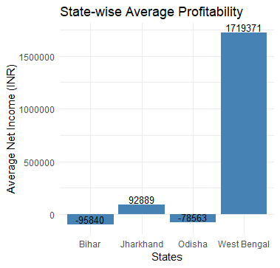
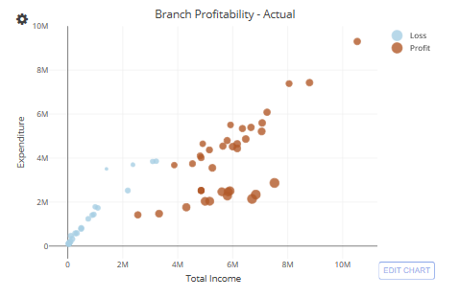
Data Exploration

Slide 6
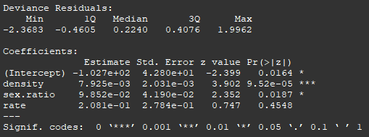
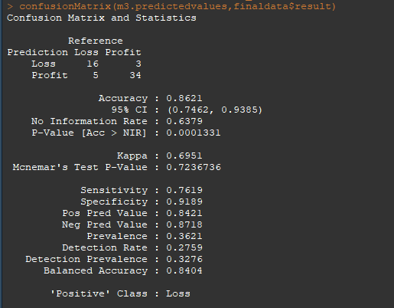
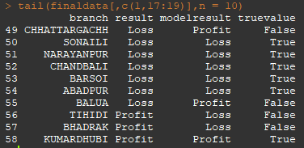
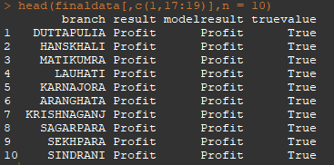
Model Parameters and Results
Model input Parameters:
Population Density
Sex Ratio
Unemployment Rate
Model Result Parameters:
Overall Accuracy : 86.21%
Correct Profit Predictions: 91.9%
Correct Loss Predictions: 76.2%

Slide 7
Marginal Effects
1. Population Density:
2. Sex Ratio:
3. Unemployment Rate:

Slide 8
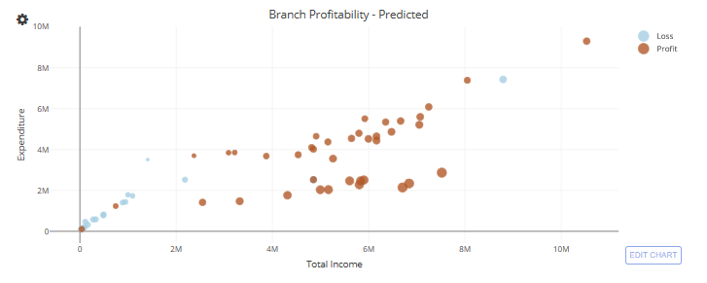
Branch Profitability – Predicted by Model

Slide 9
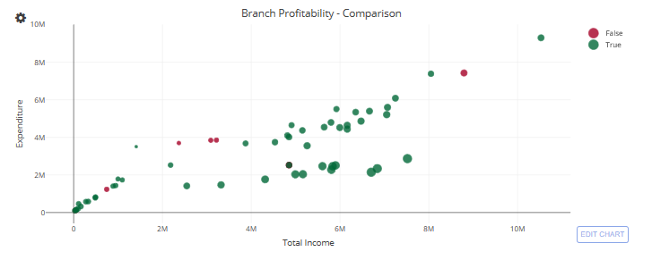
Branch Profitability - Comparison

Slide 10
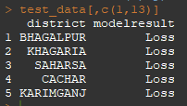
Model Results on Test Data
The model was used to predict profitability of 5 other test branches
These branches were not provided with any income / expenditure data
and predictions are only based on model input data

Slide 11
Step Ahead
Get Feedback on current work
Identify more parameters to fine tune data model
Plot the results on more interactive maps

